Slide 1


Data Compression Algorithms
Literature Review on
Students: Advisors:
Phạm Nguyễn Hải Khánh Assoc.Prof. Thoại Nam
Trần Tuấn Kiệt Ph.D. Diệp Thanh Đăng
Phạm Duy Tường Phước B.Sc La Quốc Nhựt Huân
Phan Hồng Quân

Slide 2

Table of contents
Overview on Data Compression Algorithms
Data Compression Algorithms
Results and Comparison

Slide 3
1. Overview on Data Compression Algorithms
Introduction
Scope Hierarchy

Slide 4
Introduction
“Compression algorithms are often categorized as either lossless or lossy techniques.” – Huan et al.
Lossless Technique: original data can be completely reconstructed
Lossy Technique: trade off some data errors to achieve better performance (execution time, compression ratio)

Slide 5
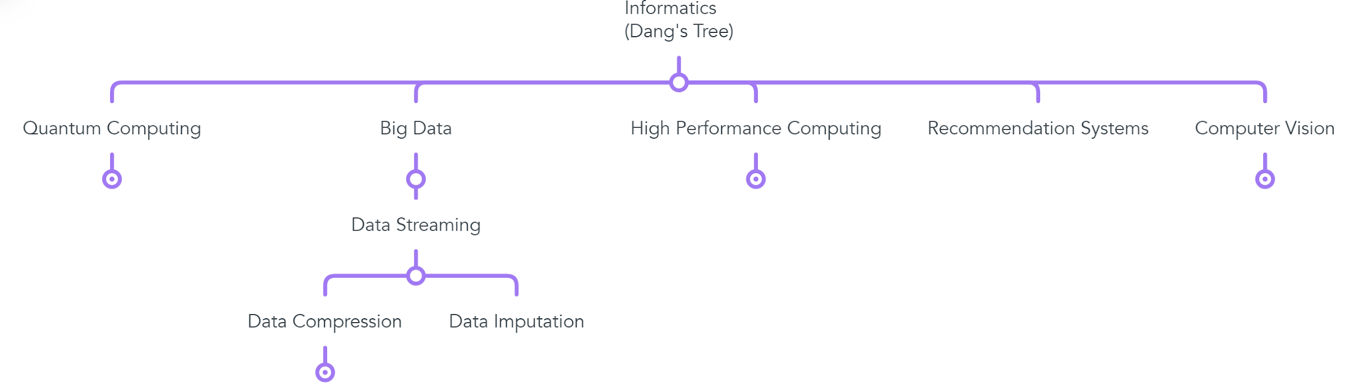
Scope Hierarchy

Slide 6
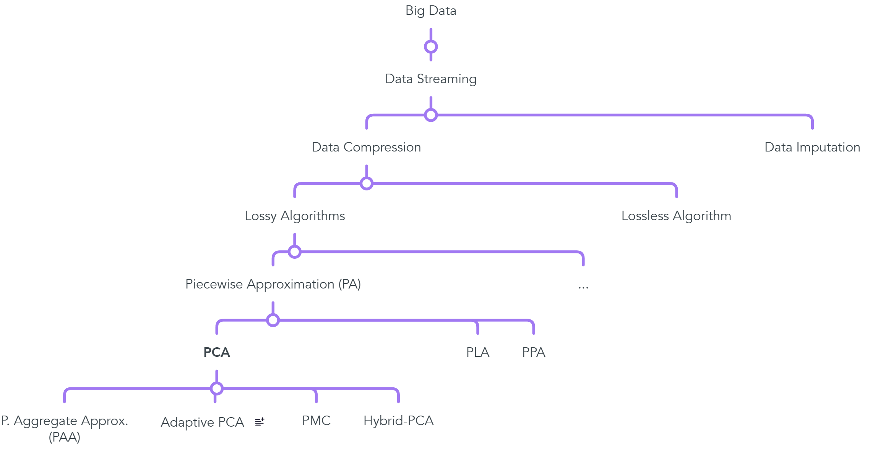
Scope Hierarchy

Slide 7
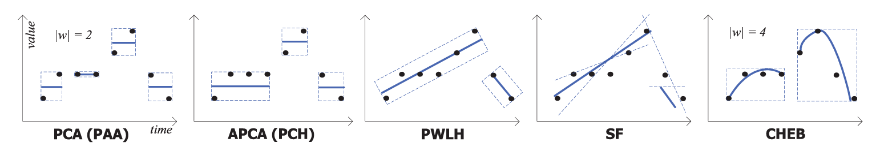
Data Compression Algorithm Overview
Fig. 1. A comparison of sensor data representations using different compression algorithms [4]
PCA: PAA, APCA
PLA: PWLH(Piecewise Linear Histogram), SF(Slide Filter)
PPA: CHEBYSHEV Polynomial

Slide 8

2. Compression Algorithms
Piecewise Aggregate Approximation (PAA)
Adaptive Piecewise Constant Approximation (APCA)
Poor Man Compression (PMC)
Hybrid - PCA

Slide 9
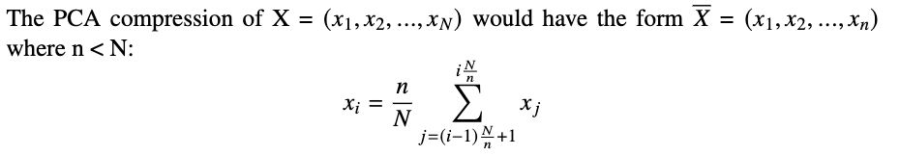
Piecewise Aggregate Approximation (PAA)
Divide the data of length N into n segments of equal length
Approximate each segment with its average value (a constant)

Slide 10
Piecewise Aggregate Approximation (PAA)
Advantages:
Simple to implement
Efficient for uniformly distributed data
Fast computation
Disadvantages:
Fixed sized segment
Less efficient for data with irregular pattern

Slide 11
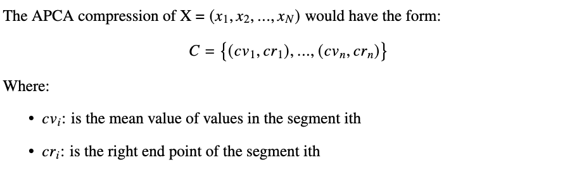
Adaptive Piecewise Constant Approximation (APCA)
Same as PCA, but relax the constraint of fixed-size segment
How: Incrementally appending data point to a window until the approximation error (the differences between actual values and segment mean) exceed a given threshold

Slide 12
Adaptive Piecewise Constant Approximation (APCA)
Advantages:
Adaptive segment size
Efficient compression while maintaining accuracy
Disadvantages:
Computationally expensive
Complex to implement
Adaptive segment logics

Slide 13
Adaptive Piecewise Constant Approximation (APCA)
APCA | PCA
Varying window size | Fixed – size windows
Fewer data points | More data points
High delay time | Low delay time

Slide 14
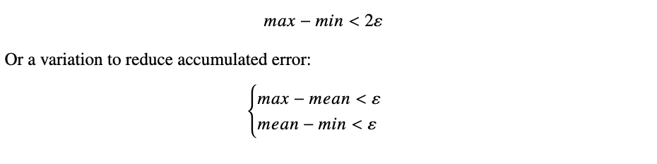
Poor Man Compression (PMC)
Like APCA, however it segmentizes the data based on a min-max approach:
For each incoming data, it incrementally updates min and max values of the segment while:
The PMC representation of the data would be the same as APCA

Slide 15
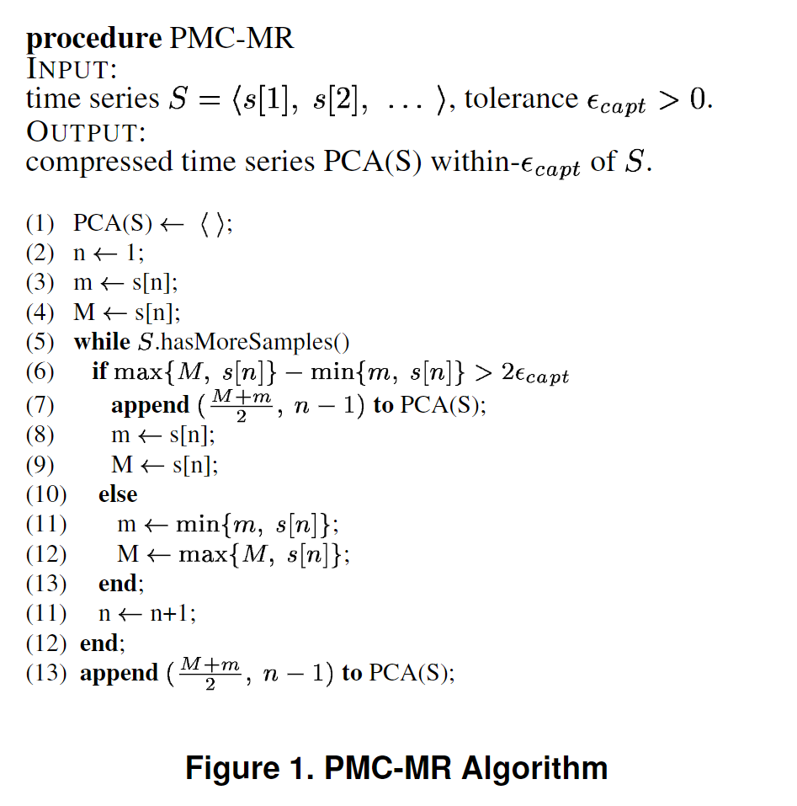
Poor Man Compression (PMC)
Fig 2. PMC-MR Algorithm [5]

Slide 16
Poor Man Compression (PMC)
Advantages:
Efficient compression
Work well for data with small noise fluctuations
Disadvantages:
Not optimal for high-precision applications
Long delay → data loss

Slide 17
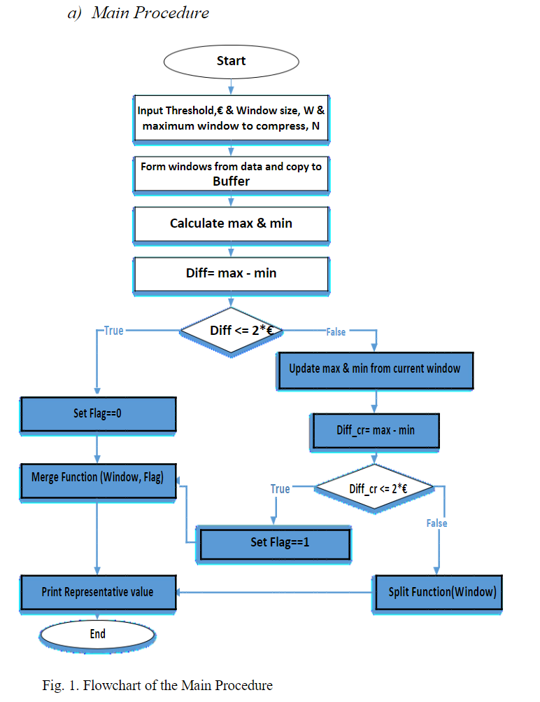
Hybrid – PCA
(Principle)
Fig. 3. Flowchart of the Main Procedure [2]

Slide 18
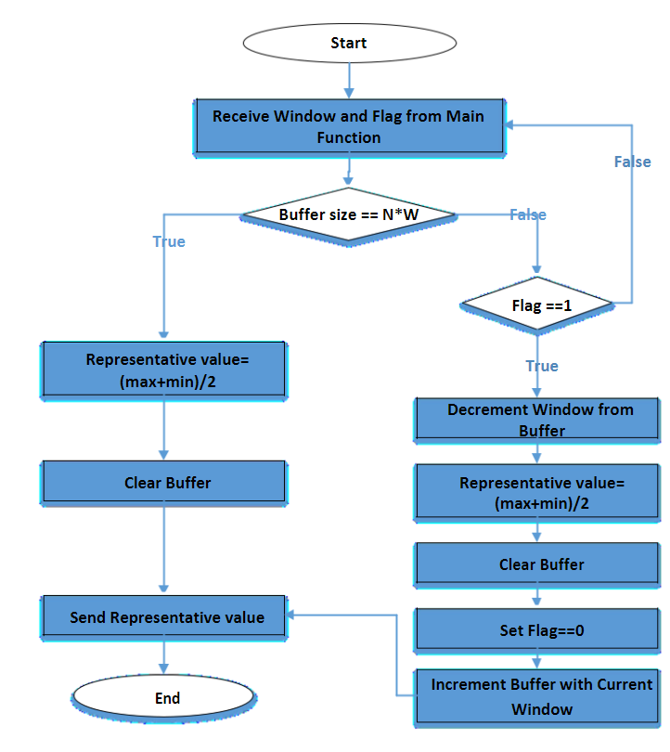
Hybrid – PCA
(Merge phase)
Fig. 4. Flowchart of the Merge Phase [2]

Slide 19
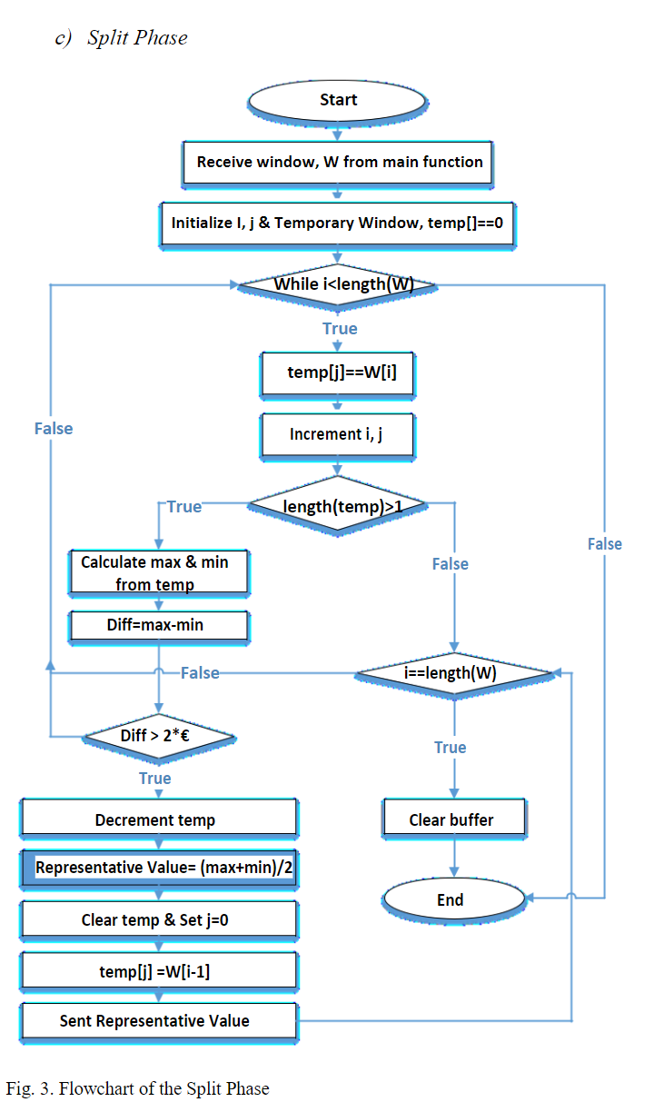
Hybrid – PCA
(Split phase)
Fig. 5. Flowchart of the Split Phase [2]

Slide 20
3. Results and Comparison
Metrics
Results

Slide 21
Metrics
Compressed Data Points
Compression Ratio
RMSE of Compression
…

Slide 22
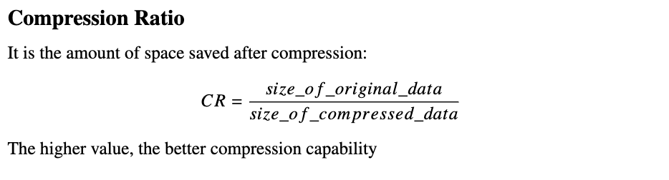
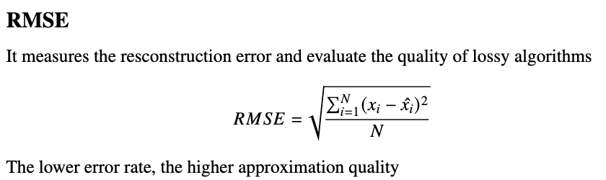
Metrics

Slide 23
Results
 | PCA |  |  | APCA |  |  | Hybrid-PCA
 | Dataset 1 | Dataset 2 | Dataset 3 | Dataset 1 | Dataset 2 | Dataset 3 | Dataset 1 | Dataset 2 | Dataset 3
Compressed Data Points | 4765 | 4453 | 12519 | 1606 | 1387 | 4911 | 2332 | 2244 | 6712
Compression Ratio | 2,27 | 2,41 | 1,71 | 6,67 | 7,74 | 4,35 | 4,55 | 4,78 | 3,18
RMSE of compression | 0,21 | 0,2 | 0,3 | 0,28 | 0,31 | 0,46 | 0,21 | 0,29 | 0,41
Table 1: A comparison of Hybrid - PCA over PCA, APCA [1]

Slide 24
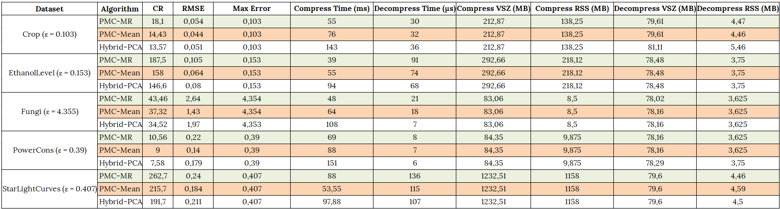
Results
Table 2: A comparison on PMC, Hybrid-PCA [1]

Slide 25
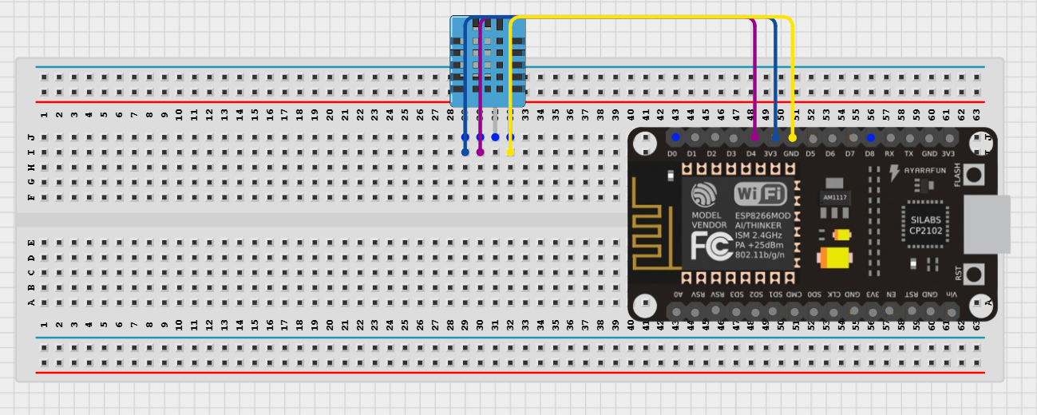
Schematic
NodeMCU ESP8266 with sensor DHT11

Slide 26

Publish to MQTT Broker over LAN

Slide 27
References
[1] Huan, Thanh-Dang Diep, and Nam Thoai. A Performance Study of Piecewise Constant Approximation in Streaming Data Compression
[2] Atik Mahbub, Farhana Haque, Habibul Bashar, Mohammad Rezwanul Huq. (2019). Improved Piecewise Constant Approximation. Method for Compressing Data Streams
[3] Arijit Ukil, Soma Bandyopadhyay, Aniruddha Sinha, Arpan Pal. (2015). Adaptive Sensor Data Compression In Iot Systems: Sensor Data Analytics Based Approach
[4] Nguyen Quoc Viet Hung, Hoyoung Jeung, and Karl Aberer, Member. (2013). An Evaluation of Model-Based Approaches to Sensor Data Compression
[5] Iosif Lazaridis, Sharad Mehrotra. (2003). Capturing Sensor-Generated Time Series with Quality Guarantees.

